Slide 1

Relationships
MINERVA
FRANCO
PROJECT 3
29 OCT 2024
Tiny blobs, medium blobs, purge, binary identities, fakers, floaters and other super unserious SQL operators

Slide 2
Table of Contents
Introduction: A Timeline
Complex Joins: Uniting Your Data
Business Question 1: Predictive Models
Business Question 2: Employee Performance Analysis
Business Question 3: Track Length Analysis
Business Question 4: Sales Prediction and Revenue Optimization
N E X T

Slide 3

I. Timeline
TUESDAY
WED
THURS
FRI
SAT
SUN
MON
BOOM
HUH
HELLO
WHAT
PROJECT
DATABASE: CHINOOK
N E X T
11 Tables, 69 Columns
8 Employees, 59 Customers
Data collected from Jan 2009 thru Dec 2013
24 Countries, USA has the most customers (13)

Slide 4

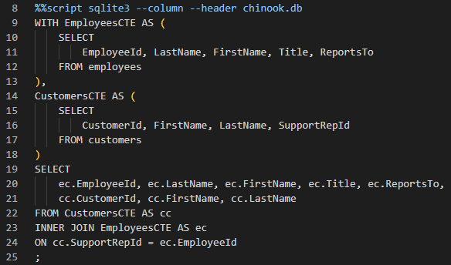
WITH
CTE name
CTE body
II.Complex Joins: Uniting
Your Data
Complex joins are essential for combining information from related tables.
CTEs (Common Table Expressions) make complex joins more readable.
INNER JOIN: Returns only matching rows from both tables.
N E X T
CTE usage
Inner Join

Slide 5

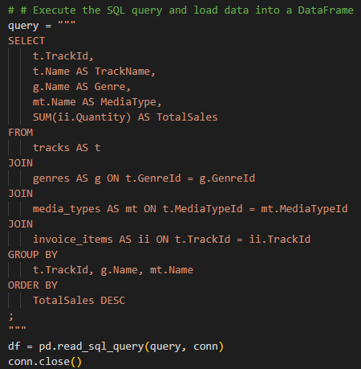

Business need: Predict which genres and media types will sell best to plan next album launches.
Question: How do I access data on genres and media types & determine if features are predictive?
III. Predictive Models: Looking Ahead
N E X T
Data Extraction: Used 3 joins to gather data from 4 tables.
Model: Random Forest Regressor does not require one-hot encoding categorical variables (genre, media type)
Outcome: The model's performance is evaluated using Mean Squared Error (MSE)=0.14 indicating features can be good indicators of sales.

Slide 6


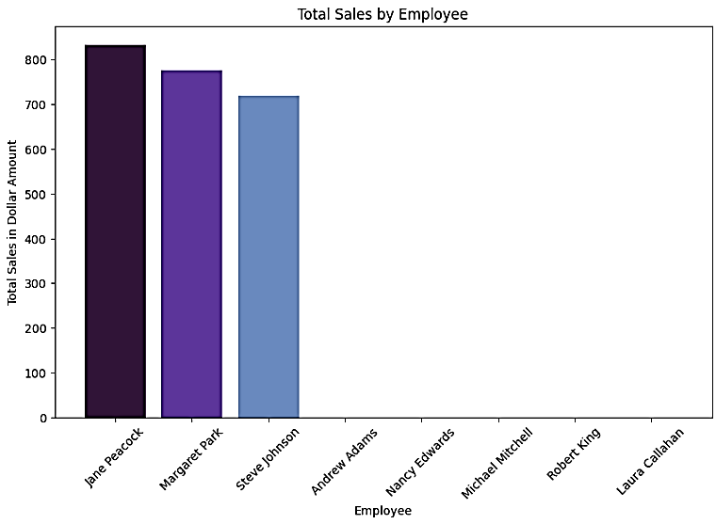

IV. Employee Performance Analysis:
All NPCs , no squad.
Business Need: Understanding which employees generate the most sales to recognize top performers and inform training / incentive programs.
Question: How do I calculate total sales for employees?
N E X T
Method: Left joined 3 tables to aggregate sales data by employee, showing how much each employee has sold based on the invoices associated with customers they support.

Slide 7


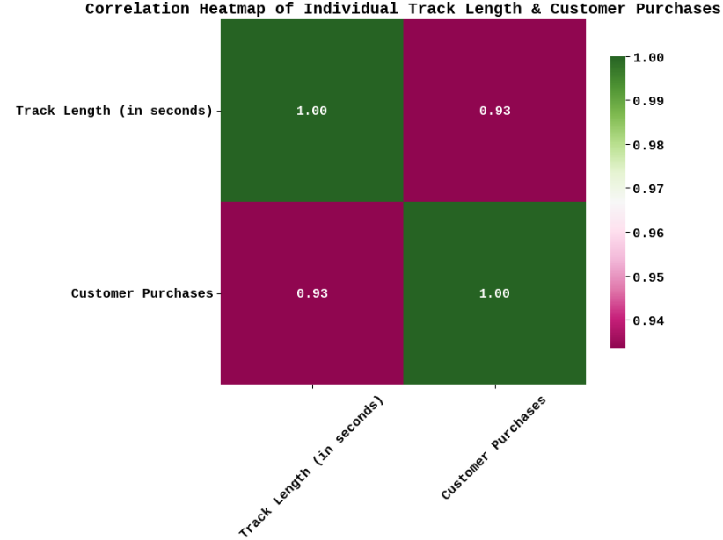
V: Track Length Analysis: Correlation Station
Business need: Analyze track length preferences to understand customer engagement and guide music production strategies
N E X T
Question: How do I retrieve a list of tracks along with the distribution of track length across different music genres?

Slide 8


Thank you for listening
Questions?
N E X T

Slide 9
Credits
N E X T
https://www.sqlitetutorial.net/wp-content/uploads/2018/03/chinook.zip
https://www.collidu.com/presentation-sql-joins
Follow me for more dating tips.

Slide 10
II.Complex Joins: Uniting Your Data
III. Predictive Models: Looking Ahead

Slide 11
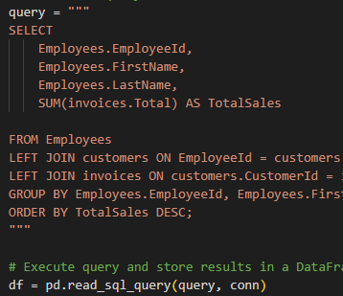
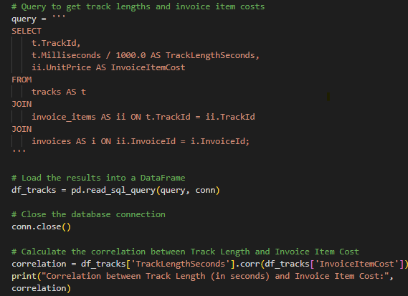
IV. Employee Performance Analysis:
All NPCs , no squad.
V: Track Length Analysis: Correlation Station

Slide 12

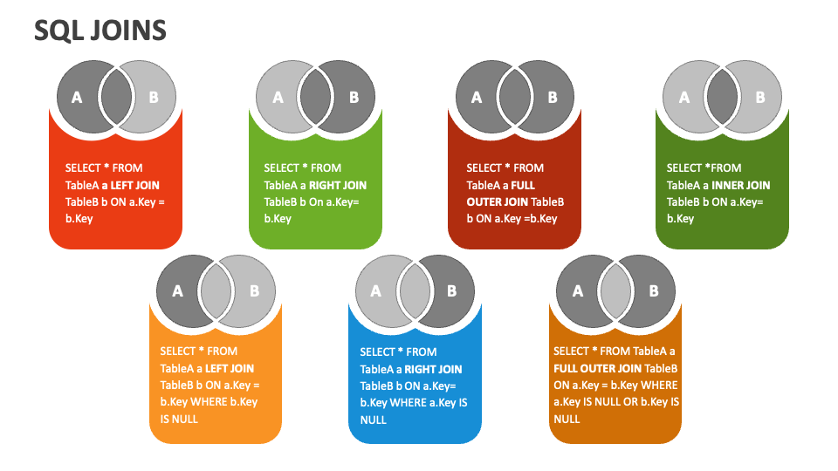
https://www.collidu.com/presentation-sql-joins
N E X T
123,456,789
ELABORATE ON THE FEATURED STATISTIC.

Slide 13



Meet Our Team
NO MORE NEXT
NAME SURNAME
NAME SURNAME
NAME SURNAME
Title
Title
Title

